Slide 1

Functions and Function Notation
College Algebra

Slide 2
Overview
Functions
Motivation
Domain and Range
Function Notation

Slide 3
Motivation
Functions and Function Notation

Slide 4
Motivating Example
Let’s get used to the concept of a function before we before we start using numbers.

Slide 5
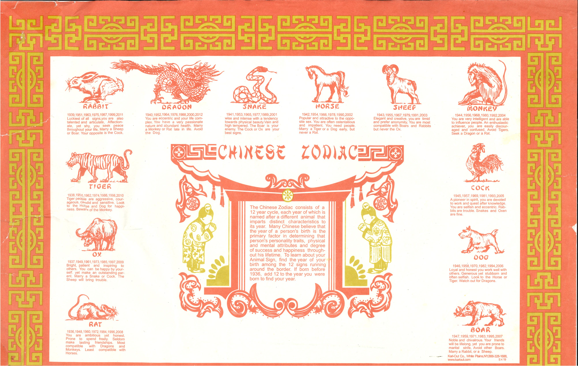
Chinese Zodiac

Slide 6
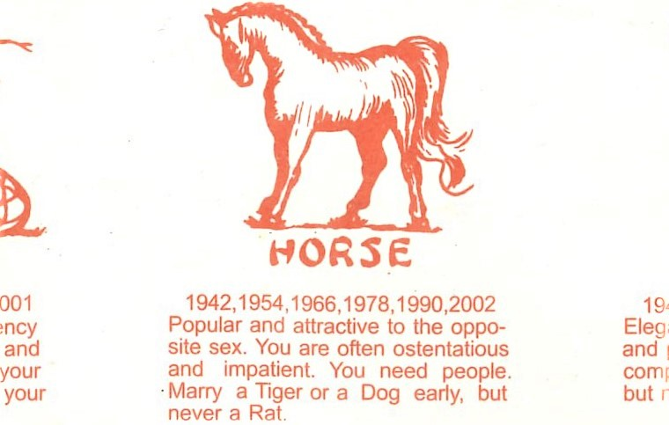
A Closer Look 1
Every year corresponds to exactly one sign in the Chinese Zodiac
The year 1942 corresponds to the Horse

Slide 7
A Closer Look 2
Every sign has exactly one opposite sign.
The sign opposite the Horse is the Rat.

Slide 8
A Closer Look 3
Every sign has two friendly signs.
The friends of the horse are the Tiger and Dog.

Slide 9
Functions
Functions and Function Notation

Slide 10
Definition of a Function
A function is a relation in which each possible input value leads to exactly one output value. We say, “the output is a function of the input.”

Slide 11
Summary
The correspondence from years to signs is a function.
The correspondence from signs to opposite signs is a function.
The correspondence from signs to friendly signs is not a function.

Slide 12
Domain and Range
Functions and Function Notation

Slide 13
Definition of Domain and Range
The input values of a function make up the domain, and the output values make up the range.

Slide 14
Example 1
For the function between years and signs:
The domain is the set of all years.
The range is the set of all signs.

Slide 15
Example 2
For the function between signs and opposite signs:
The domain is the set of all signs.
The range is also the set of all signs.

Slide 16
Note
Domain and range are more important later in the course.

Slide 17
Function Notation
Functions and Function Notation

Slide 18
Idea Behind Function Notation
Writing “The sign corresponding to the year 1942 is the Horse” takes a lot of time.
To save writing, we use function notation.

Slide 19

Definition of Function Notation
The notation $y=f\left(x\right)$ defines a function named $f$.
This is read as ”$y$ is a function of $x$”.
The variable $x$ represents the input value, or independent variable.
The variable $y$, represents the output value, or dependent variable.

Slide 20

Example 3
Years | Sign
… 1972, 1984, 1996 … | Rat
… 1973, 1985, 1997 … | Ox
… 1974, 1986, 1998 … | Tiger
… 1975, 1987, 1999 … | Rabbit
… 1976, 1988, 2000 … | Dragon
… 1977, 1989, 2001 … | Snake
… 1978, 1990, 2002 … | Horse
… 1979, 1991, 2003 … | Sheep
… 1980, 1992, 2004 … | Monkey
… 1981, 1993, 2005 … | Rooster
… 1982, 1994, 2006 … | Dog
… 1983, 1995, 2007 … | Boar
Let $s$ be the function that tells the sign that corresponds to a year.
$s\left(1987\right)=\text{Rabbit}$
$s\left(1981\right)=\text{Rooster}$
$s\left(2001\right)=\text{Snake}$

Slide 21

Example 4
Sign | Opposite
Rat | Horse
Ox | Sheep
Tiger | Monkey
Rabbit | Rooster
Dragon | Dog
Snake | Boar
Horse | Rat
Sheep | Ox
Monkey | Tiger
Rooster | Rabbit
Dog | Dragon
Boar | Snake
Let $o$ be the function that tells the opposite of a sign.
$o\left(\text{Rabbit}\right)=\text{Rooster}$
$o\left(\text{Dragon}\right)=\text{Dog}$
$o\left(\text{Tiger}\right)=\text{Monkey}$

